Slide 1


Day 1: Basic Python & Core Concepts
Sean Wong
2025/08/05

Slide 2



CONTENTS
01.
02.
03.
Kick-off & Setup
Core Syntax
Practice & Wrap-up

Slide 3



01
Kick-off & Setup

Slide 4

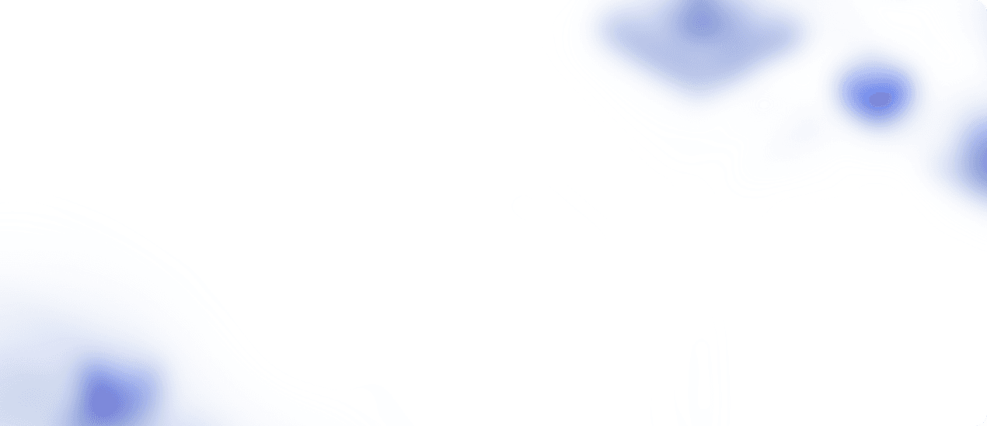
Basic Python & Core Concepts
Introduction
Welcome to the Weekend Python Crash Course! Today, we'll dive into Python basics and core concepts. By the end of this session, you'll have a solid foundation to start your Python journey. Let's get started!

Slide 5
Course Objectives (Day 1)
01
03
02
04
Understand Python
Run Scripts
Setup Python
Core Concepts
Learn what Python is, its popularity, and its applications in web development, data science, automation, and more. Discover why Python is a great choice for beginners and professionals alike.
Learn to run Python scripts and use the REPL. Create your first script, 'hello.py', and see Python in action with print('Hello, Python!').
Install Python from python.org and set up an IDE like VS Code, PyCharm, or Jupyter Notebook. Verify your installation with a simple script.
Master variables, data types, basic operators, and control flow with if/else and loops. Build small programs to reinforce these concepts.

Slide 6
02
Core Syntax

Slide 7




What is Python?
High-Level Language
Versatile Applications
Python is a high-level, interpreted programming language known for its readability and ease of use. It's perfect for beginners and powerful enough for professionals.
Python is used in web development, data science, automation, games, and more. Its large community and extensive libraries make it a versatile tool for various tasks.

Slide 8



Setting Up Python
1
3
2
Installation Steps
Verify Installation
IDE Options
Download and install Python from python.org. Follow the installation wizard and ensure Python is added to your system's PATH for easy access.
Open your terminal or command prompt and type 'python --version' to verify that Python is installed correctly on your system.
Choose an IDE like VS Code, PyCharm, or Jupyter Notebook. These tools provide a user-friendly environment for writing and running Python code.

Slide 9


Running Your First Script
Create a Script
01
Understand the difference between running code in the REPL (interactive shell) and executing a script. The REPL is great for quick tests, while scripts are for larger programs.
REPL vs Script
02
Create a file named 'hello.py' and write the code: print('Hello, Python!'). Save the file and run it using your IDE or terminal.
View Output
03
When you run 'hello.py', you should see 'Hello, Python!' printed in the terminal. This is your first Python program in action!

Slide 10
03
Practice & Wrap-up

Slide 11

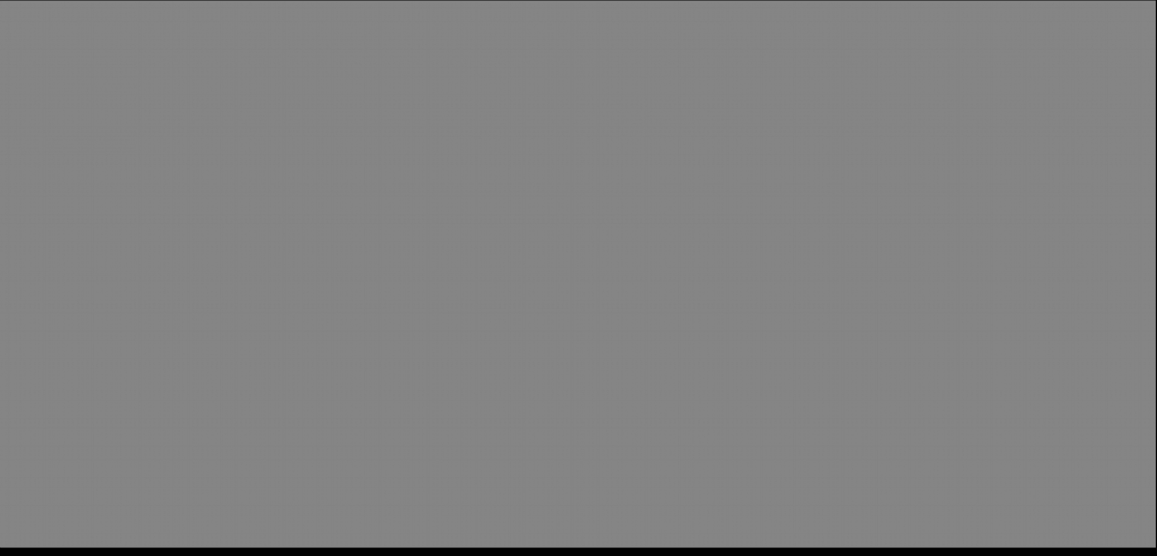
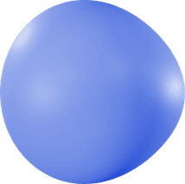


Variables
01
02
Definition
Naming Rules
Variables are used to store data values. In Python, you can assign a value to a variable using the '=' operator. For example: name = 'Alice'.
Variable names must start with a letter or underscore, and can include letters, numbers, and underscores. Use descriptive names for clarity.

Slide 12

Data Types
int
str
Integers are whole numbers without a decimal point. Example: age = 25. Use them for counting and arithmetic operations.
Strings are sequences of characters enclosed in quotes. Example: name = 'Alice'. Use them to store text data.
float
bool
Floats are numbers with a decimal point. Example: height = 1.65. They are useful for precise calculations.
Booleans represent True or False values. They are used in conditional statements and logical operations.

Slide 13

Basic Operators
1
Arithmetic Operators
Use +, -, *, /, and % for basic arithmetic. For example: a = 10; b = 3; print(a + b) will output 13.
2
Integer vs Float Division
Be aware of the difference between integer division (//) and float division (/). For example: 10 / 3 gives 3.333, while 10 // 3 gives 3.
Example Code
3
Try this code: a = 10; b = 3; print(a + b, a - b, a * b, a / b, a % b). This will help you understand how operators work in Python.

Slide 14


Input and Output
User Input
Use the input() function to get user input. It always returns a string. For example: name = input('Enter your name: ')
Printing Output
Use the print() function to display output. You can concatenate strings or use formatted strings. For example: print('Hello, ' + name)

Slide 15

Control Flow – If / Else
1
2
3
Conditional Statements
Logical Operators
Example Scenarios
Use if, elif, and else to create conditional logic. For example: if age >= 18: print('Adult') else: print('Minor')
Combine conditions using logical operators like and, or, and not. For example: if age >= 18 and age <= 65: print('Working age')
Try this example: num = int(input('Enter a number: ')); if num > 0: print('Positive') elif num < 0: print('Negative') else: print('Zero')

Slide 16

Loops – For
1
For Loop
Use the for loop to iterate over a sequence. For example: for i in range(5): print(i). This will print numbers from 0 to 4.
2
Iterating Over Lists
You can also iterate over lists or strings. For example: my_list = [1, 2, 3]; for item in my_list: print(item)

Slide 17


Loops – While
While Loop
Termination Condition
Example
Use the while loop to repeat a block of code as long as a condition is true. For example: count = 0; while count < 5: print(count); count += 1
Ensure your while loop has a clear termination condition to avoid infinite loops. For example: while True: break
Try this example: count = 0; while count < 5: print(count); count += 1. This will print numbers from 0 to 4.

Slide 18


Mini Exercises
Print Even Numbers
Number Guessing Game
Write a program to print all even numbers from 1 to 20. Use a for loop and the modulo operator to check for even numbers.
Pair Programming
Create a number guessing game. Use a while loop to let the user guess a number between 1 and 10. Provide hints like 'Too high!' or 'Too low!'
Encourage pair programming to solve these exercises. Collaborate with a partner to share ideas and debug together.

Slide 19

End-of-Day Challenge
01
02
Personalized Message
Repeat for Multiple Users
Create a program that asks for the user's name, age, and favorite number. Print a message like: 'Hello <name>! In 5 years, you will be <age+5>. Your favorite number doubled is <favorite_number*2>.'
Extend the program to repeat for 3 users using a loop. This will help you practice input, loops, and string formatting.

Slide 20


Tips & Best Practices
Save Scripts Frequently
Experiment and Debug
Always save your scripts frequently to avoid losing your work. Use meaningful file names and organize your projects.
Don't be afraid to experiment with different code snippets. Use print statements or debugging tools to understand and fix errors.
Comment Your Code
Ask Questions
Add comments to explain complex logic or important steps in your code. This will make it easier for others (and yourself) to understand.
If you're stuck, don't hesitate to ask questions. Collaboration and community support are key to learning and solving problems.

Slide 21
Resources
Official Documentation
Replit Online IDE
Refer to the Python Official Documentation for detailed information and examples: [Python Docs](https://docs.python.org/3/)
Use Replit for an online coding environment: [Replit](https://replit.com/)
Automate the Boring Stuff
W3Schools Python Tutorial
A great resource for practical Python projects: [Automate the Boring Stuff](https://automatetheboringstuff.com/)
A comprehensive tutorial for beginners: [W3Schools Python](https://www.w3schools.com/python/)

Slide 22

Thank You / Next Steps
Practice at Home
Preview Day 2
Q&A
Encourage learners to practice the exercises at home. Repetition is key to mastering programming concepts.
Preview topics for Day 2: Functions, Data Structures, Strings, and File Handling. Get ready to dive deeper into Python!
Open the floor for any questions or feedback. Thank you for participating in today's session!

Slide 23

THANK YOU！
Sean Wong
2025/08/05

